Slide 1

Course Name - Object Oriented Programming using Java
Lecture 7– Access specifiers, Operators, Control statements & loops
Presented By
Dr. Sudipta Sahana
Asso. Prof.
Dept. of CSE
UEM - Kolkata

Slide 2
Topic of Interest
Access specifiers
Access Control Modifiers
Non-Access Modifiers Object
Operators
Control statements
If statement
If...else statement
Nested if statement
Switch statement
Java Loop
For loop
While loop
Do...while loop

Slide 3
Access specifiers
Modifiers/specifiers are keywords that you add to those definitions to change their meanings. Java language has a wide variety of modifiers, including the following −
Java Access Modifiers
Non Access Modifiers

Slide 4
Access Control Modifiers:
Java provides a number of access modifiers to set access levels for classes, variables, methods. The four access levels are −
Visible to the package, the default. No modifiers are needed.
Visible to the class only (private).
Visible to the world (public).
Visible to the package and all subclasses (protected).
.

Slide 5
Non-Access Modifiers:
Java provides a number of non-access modifiers to achieve many other functionality.
The static modifier for creating class methods and variables.
The final modifier for finalizing the implementations of classes, methods, and variables.
The abstract modifier for creating abstract classes and methods.
The synchronized and volatile modifiers, which are used for threads.:

Slide 6
Operators:
Java provides a rich set of operators to manipulate variables. We can divide all the Java operators into the following groups −
Arithmetic Operators
Relational Operators
Bitwise Operators
Logical Operators
Assignment Operators
Misc Operators

Slide 7
Control statements
A control statement works as a determiner for deciding the next task of the other statements whether to execute or not. An ‘If’ statement decides whether to execute a statement or which statement has to execute first between the two. In Java, the control statements are divided into three categories which are selection statements, iteration statements, and jump statements. A program can execute from top to bottom but if we use a control statement. We can set order for executing a program based on values and logic.
if statement
if...else statement
nested if statement
switch statement

Slide 8
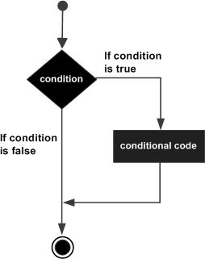
If statement
An if statement consists of a Boolean expression followed by one or more statements.
if (condition) {
Statement 1; //if condition becomes true then this will be executed
}
Statement 2; //this will be executed irrespective of condition becomes true or false
Flow diagram

Slide 9
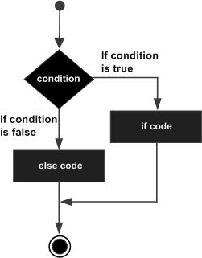
If...else statement
In if…else statement, if condition is true then statements in if block will be executed but if it comes out as false then else block will be executed..
if (condition) {
Statement 1; //if condition becomes true then this will be executed
}
Flow diagram

Slide 10
Nested if statement
Nested if statement is if inside an if block. It is same as normal if…else statement but they are written inside another if…else statement.
if (condition1) {
Statement 1; //executed when condition1 is true
if (condition2) {
Statement 2; //executed when condition2 is true
}
else {
Statement 3; //executed when condition2 is false
}
}

Slide 11
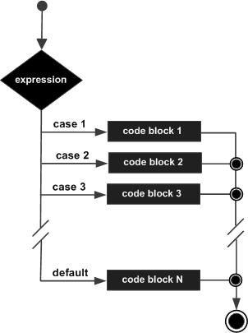
Switch statement
Java switch statement compares the value and executes one of the case blocks based on the condition. It is same as if…else if ladder. Below are some points to consider while working with switch statements:
Flow diagram

Slide 12
Java Loop
While loop
Repeats a statement or group of statements while a given condition is true. It tests the condition before executing the loop body.
For loop
Execute a sequence of statements multiple times and abbreviates the code that manages the loop variable.
Do...while loop
Like a while statement, except that it tests the condition at the end of the loop body.

Slide 13
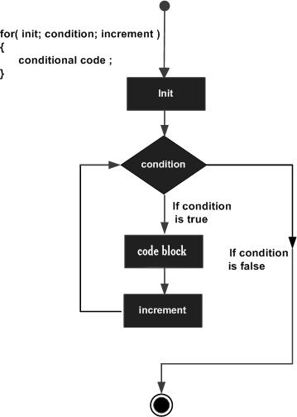
For loop
When you know exactly how many times you want to loop through a block of code, use the for loop instead of a while loop:
for (statement 1; statement 2; statement 3)
{
// code block to be executed
}

Slide 14
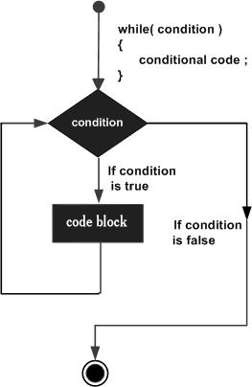
While loop
The while loop loops through a block of code as long as a specified condition is true:
while (condition) {
// code block to be executed
}

Slide 15
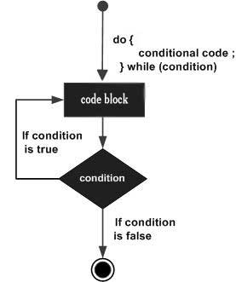
Do...while loop
The do/while loop is a variant of the while loop. This loop will execute the code block once, before checking if the condition is true, then it will repeat the loop as long as the condition is true:
do {
// code block to be executed
}
while (condition);

Slide 16
Thank You

Slide 17


